Slide 1
8051 Software Overview

Slide 2
Overview
Addressing Mode
Instruction Set
Programming

Slide 3
8051 Addressing Modes
The CPU can access data in various ways, which are called addressing modes
Immediate
Register
Direct
Register indirect
External Direct

Slide 4
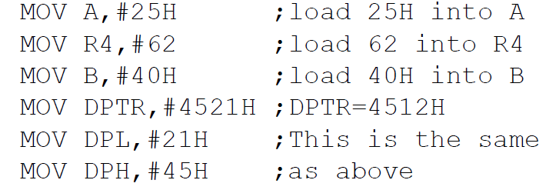
Immediate Addressing Mode
The source operand is a constant.
The immediate data must be preceded by the pound sign, “#”
Can load information into any registers, including 16-bit DPTR register
DPTR can also be accessed as two 8-bit registers, the high byte DPH and low byte DPL

Slide 5
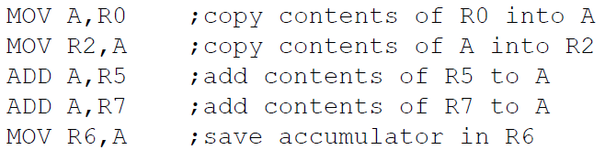

Register Addressing Mode
Use registers to hold the data to be manipulated.
The source and destination registers must match in size.
MOV DPTR,A will give an error
The movement of data between Rn registers is not allowed
MOV R4,R7 is invalid

Slide 6

Direct Addressing Mode
It is most often used the direct addressing mode to access RAM locations 30 – 7FH.
The entire 128 bytes of RAM can be accessed.
Contrast this with immediate addressing mode, there is no “#” sign in the operand.

Slide 7
SFR Registers & their Addresses
MOV 0E0H,#55H ;is the same as
MOV A,#55H ;which means load 55H into A (A=55H)
MOV 0F0H,#25H ;is the same as
MOV B,#25H ;which means load 25H into B (B=25H)
MOV 0E0H,R2 ;is the same as
MOV A,R2 ;which means copy R2 into A
MOV 0F0H,R0 ;is the same as
MOV B,R0 ;which means copy R0 into B

Slide 8
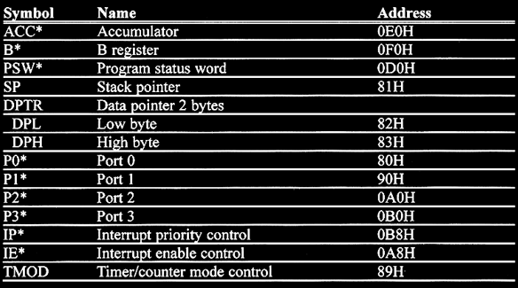
SFR Addresses ( 1 of 2 )

Slide 9
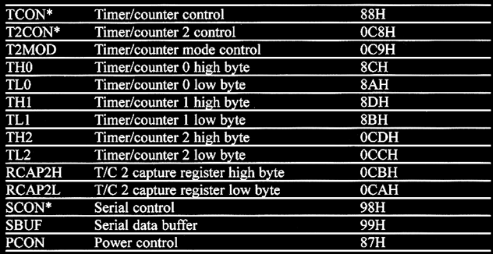
SFR Addresses ( 2 of 2 )

Slide 10
Example
Write a code send 55H to ports P1 and P2, using (a) their names and (b) their address.

Slide 11
Example
Write a code send 55H to ports P1 and P2, using (a) their names and (b) their address.
Solution:
MOV A, #55H
MOV P1, A
MOV P2, A
MOV A, #55H
MOV 80H, A
MOV 0A0H, A

Slide 12
Stack and Direct Addressing Mode
Show the code to push R5 and A onto the stack and then pop them into R2 and B, where B = A and R2 = R5.
Solution: ??????

Slide 13
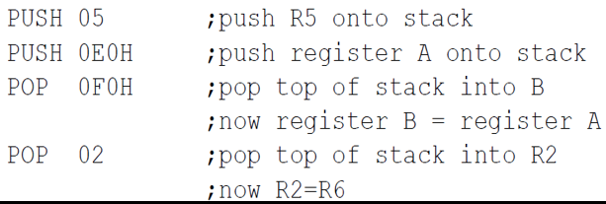
Stack and Direct Addressing Mode
Show the code to push R5 and A onto the stack and then pop them into R2 and B, where B = A and R2 = R5.
Solution:

Slide 14
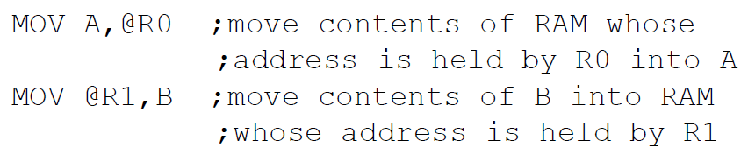
Register Indirect Addressing Mode
A register is used as a pointer to the data.
Only register R0 and R1 are used for this purpose.
R2 – R7 cannot be used to hold the address of an operand located in RAM.
When R0 and R1 hold the addresses of RAM locations, they must be preceded by the “@” sign.

Slide 15
Register Indirect Addressing Mode
Write a program to copy the value 55H into RAM memory locations 40H to 41H using (a) direct addressing mode, (b) register indirect addressing mode without a loop, and (c) with a loop.
Solution????

Slide 16
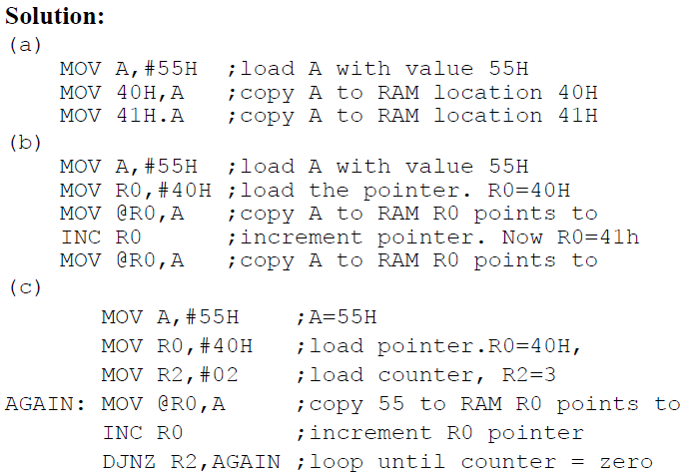
Register Indirect Addressing Mode
Write a program to copy the value 55H into RAM memory locations 40H to 41H using (a) direct addressing mode, (b) register indirect addressing mode without a loop, and (c) with a loop.
Solution for (a)

Slide 17
Register Indirect Addressing Mode
Write a program to copy the value 55H into RAM memory locations 40H to 41H using (a) direct addressing mode, (b) register indirect addressing mode without a loop, and (c) with a loop.
Solution for (b)

Slide 18
Register Indirect Addressing Mode
Write a program to copy the value 55H into RAM memory locations 40H to 41H using (a) direct addressing mode, (b) register indirect addressing mode without a loop, and (c) with a loop.
Solution for (c)

Slide 19
Register Indirect Addressing Mode
The advantage is that it makes accessing data dynamic rather than static as in direct addressing mode.
Looping is not possible in direct addressing mode.
Write a program to clear 16 RAM locations starting at RAM address 60H.
Solution: ????

Slide 20
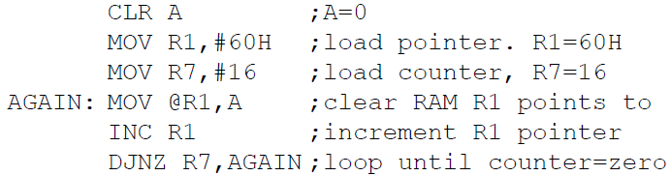
Register Indirect Addressing Mode
The advantage is that it makes accessing data dynamic rather than static as in direct addressing mode.
Looping is not possible in direct addressing mode.
Write a program to clear 16 RAM locations starting at RAM address 60H.
Solution:

Slide 21
External Direct
External Memory is accessed.
There are only two commands that use External Direct addressing mode:
MOVX A, @DPTR MOVX @DPTR, A
DPTR must first be loaded with the address of external memory.

Slide 22
Instruction Set
8051 instructions have 8-bit opcode
There are 256 possible instructions of which 255 are implemented.

Slide 23
ASSEMBLER DIRECTIVES
The assembling directives give the directions to the CPU. The 8051 microcontroller consists of various kinds of assembly directives to give the direction to the control unit. The most useful directives are 8051 programming, such as:
ORG
DB
EQU
END

Slide 24
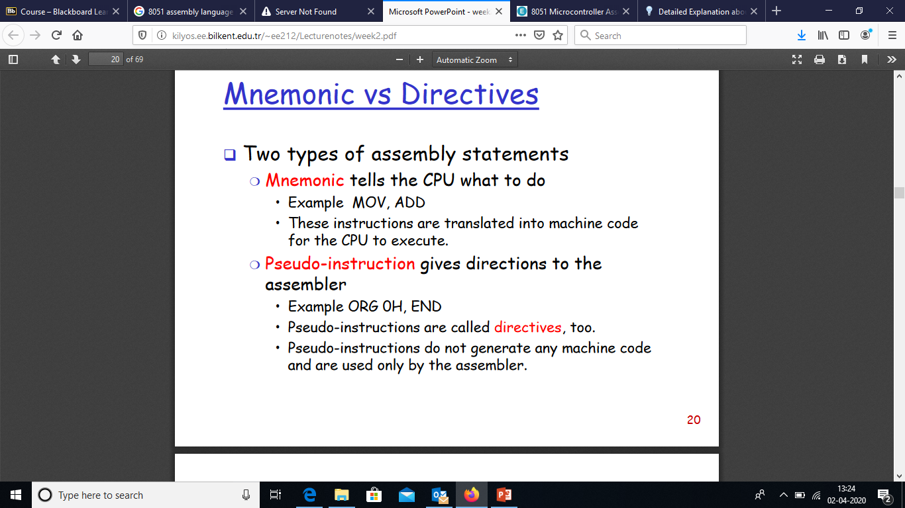

Slide 25
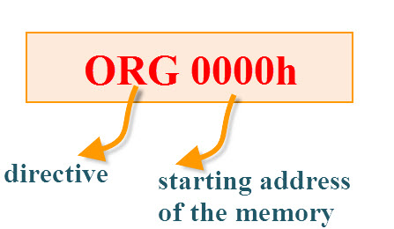
ORG (Origin)
This directive indicates the start of the program.
This is used to set the register address during assembly.
For example; ORG 0000h tells the compiler all subsequent code starting at address 0000h

Slide 26
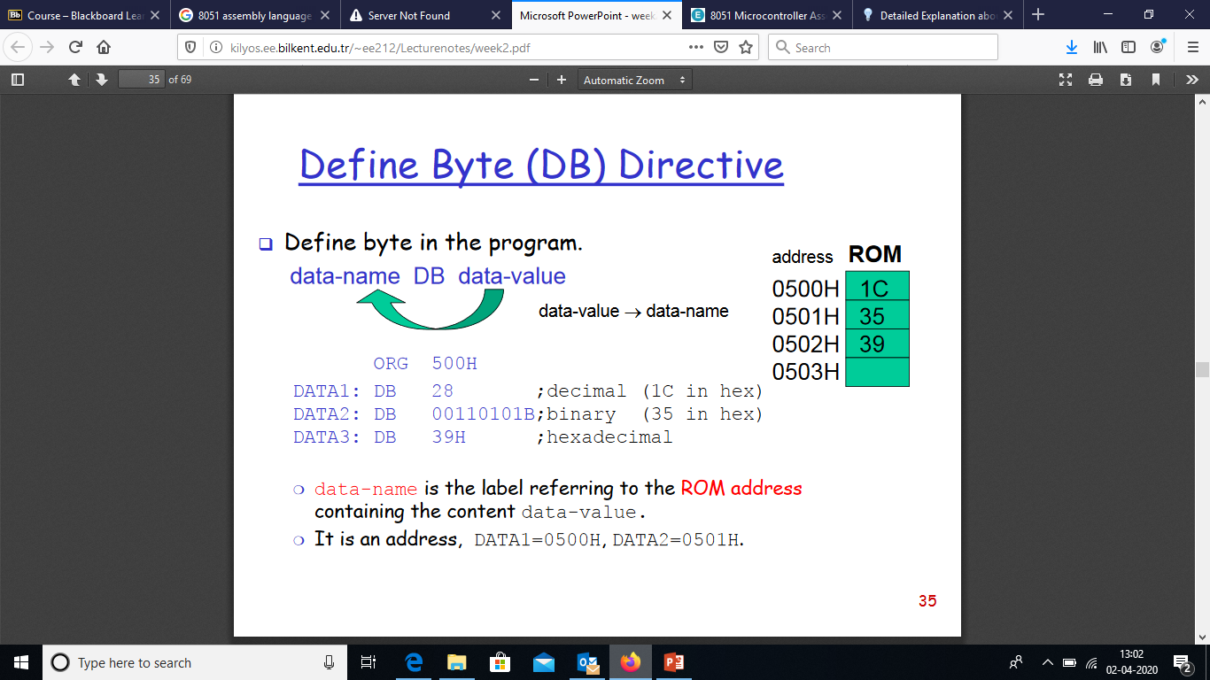

Slide 27
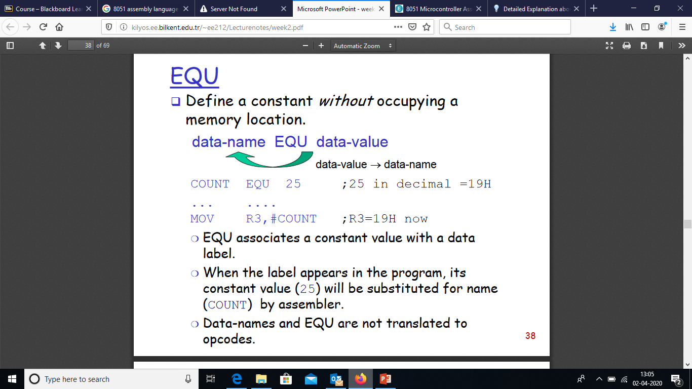

Slide 28
End
END:The END directive is used to indicate the end of the program.
Syntax:
reg equ,09h
—————– —————– MOV reg,#2h END

Slide 29
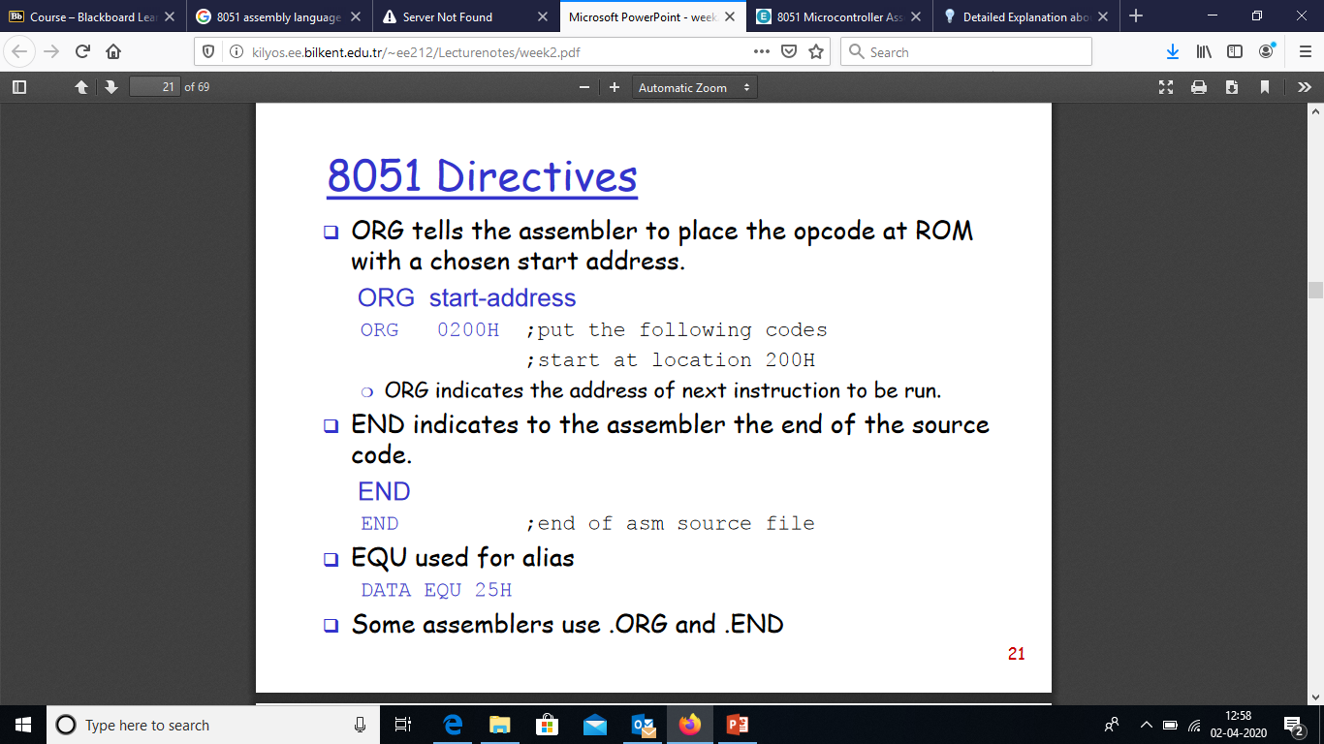

Slide 30
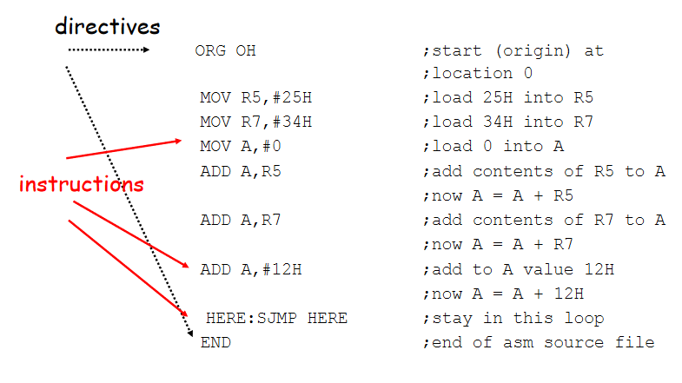

Slide 31
MOV Instruction
MOV destination, source ; copy source to destination.
MOV A,#55H ;load value 55H into reg. A MOV R0,A ;copy contents of A into R0 ;(now A=R0=55H) MOV R1,A ;copy contents of A into R1 ;(now A=R0=R1=55H) MOV R2,A ;copy contents of A into R2 ;(now A=R0=R1=R2=55H) MOV R3,#95H ;load value 95H into R3 ;(now R3=95H) MOV A,R3 ;copy contents of R3 into A ;now A=R3=95H

Slide 32
ADD Instruction
ADD A, source ;ADD the source operand to the accumulator
MOV A, #25H ;load 25H into A MOV R2,#34H ;load 34H into R2 ADD A,R2 ;add R2 to accumulator ;(A = A + R2)

Slide 33
Structure of Assembly Language
ORG 0H ;start (origin) at location 0 MOV R5,#25H ;load 25H into R5 MOV R7,#34H ;load 34H into R7 MOV A,#0 ;load 0 into A ADD A,R5 ;add contents of R5 to A ;now A = A + R5 ADD A,R7 ;add contents of R7 to A ;now A = A + R7 ADD A,#12H ;add to A value 12H ;now A = A + 12H
HERE: SJMP HERE ;stay in this loop END ;end of asm source file

Slide 34
Data Types & Directives
ORG 500H
DATA1: DB 28 ;DECIMAL (1C in Hex)
DATA2: DB 00110101B ;BINARY (35 in Hex)
DATA3: DB 39H ;HEX
ORG 510H
DATA4: DB “2591” ; ASCII NUMBERS
ORG 518H
DATA6: DB “My name is Joe” ;ASCII CHARACTERS

Slide 35
ADD Instruction and PSW
Show the status of the CY, AC and P flags after the addition of 38H and 2FH in the following instructions.
MOV A,#38H
ADD A, #2FH ; after the addition A = 67H, CY = 0
Solution:????

Slide 36


ADD Instruction and PSW
Show the status of the CY, AC and P flags after the addition of 38H and 2FH in the following instructions.
MOV A,#38H
ADD A, #2FH ; after the addition A = 67H, CY = 0
Solution:

Slide 37
ADD Instruction and PSW
Show the status of the CY, AC and P flags after the addition of 9CH and 64H in the following instructions.
MOV A,#9CH
ADD A, #64H ; after the addition A = 00H, CY = 1
Solution:????

Slide 38


ADD Instruction and PSW
Show the status of the CY, AC and P flags after the addition of 9CH and 64H in the following instructions.
MOV A,#9CH
ADD A, #64H ; after the addition A = 00H, CY = 1
Solution:

Slide 39

Multiplication of Unsigned Numbers
MUL AB ; A x B, place 16-bit result in B and A
MOV A,#25H ;load 25H to reg. A
MOV B,#65H ;load 65H in reg. B
MUL AB ;25H * 65H = E99 where B = 0EH and A = 99H

Slide 40

Division of Unsigned Numbers
DIV AB ; divide A by B
MOV A,#95H ;load 95 into A
MOV B,#10H ;load 10 into B
DIV AB ;now A = 09 (quotient) and B = 05 (remainder)

Slide 41
Checking an input bit
JNB (jump if no bit) ; JB (jump if bit = 1)
Assume that bit P2.3 is an input and represents the condition of an oven. If it goes high, it means that the oven is hot. Monitor the bit continuously. Whenever it goes high, send a high-to-low pulse to port P1.5 to turn on a buzzer.
Solution????

Slide 42
Checking an input bit
JNB (jump if no bit) ; JB (jump if bit = 1)
Assume that bit P2.3 is an input and represents the condition of an oven. If it goes high, it means that the oven is hot. Monitor the bit continuously. Whenever it goes high, send a high-to-low pulse to port P1.5 to turn on a buzzer.
Solution:
HERE: JNB P2.3, HERE ; Keep monitoring for high
SETB P1.5 ; Set bit P1.5 = 1
CLR P1.5 ; make high-to-low

Slide 43
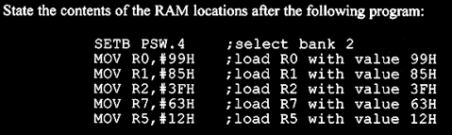
Switch Register Banks
Solution????

Slide 44
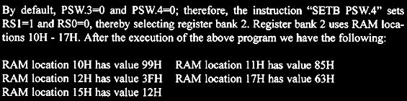
Switch Register Banks
Solution:

Slide 45
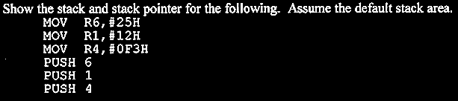
Pushing onto Stack
Solution????

Slide 46
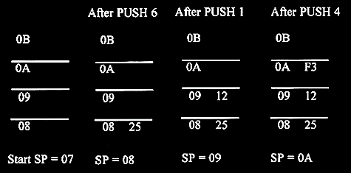
Pushing onto Stack
Solution:

Slide 47
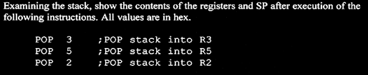
Popping from Stack
Solution????

Slide 48
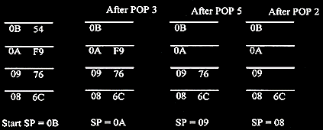
Popping from Stack
Solution:

Slide 49
Looping
Write a program to
Clear ACC, then
Add 3 to the accumulator ten times.

Slide 50
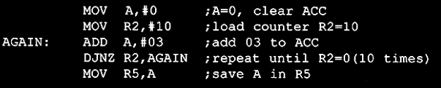
Looping
Write a program to
Clear ACC, then
Add 3 to the accumulator ten times.

Slide 51
Loop inside a Loop (Nested Loop)
Write a program to (a) load the accumulator with the values 55H and (b) complement the ACC 700 times.
Solution??

Slide 52
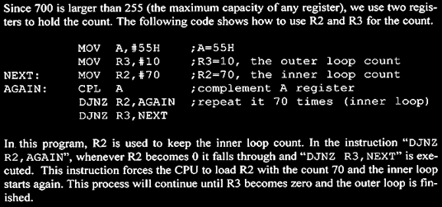
Loop inside a Loop (Nested Loop)
Write a program to (a) load the accumulator with the values 55H and (b) complement the ACC 700 times.
Solution:

Slide 53
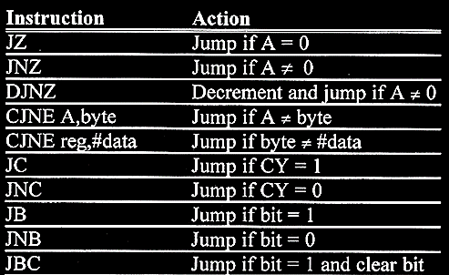
8051 Conditional Jump Instructions

Slide 54
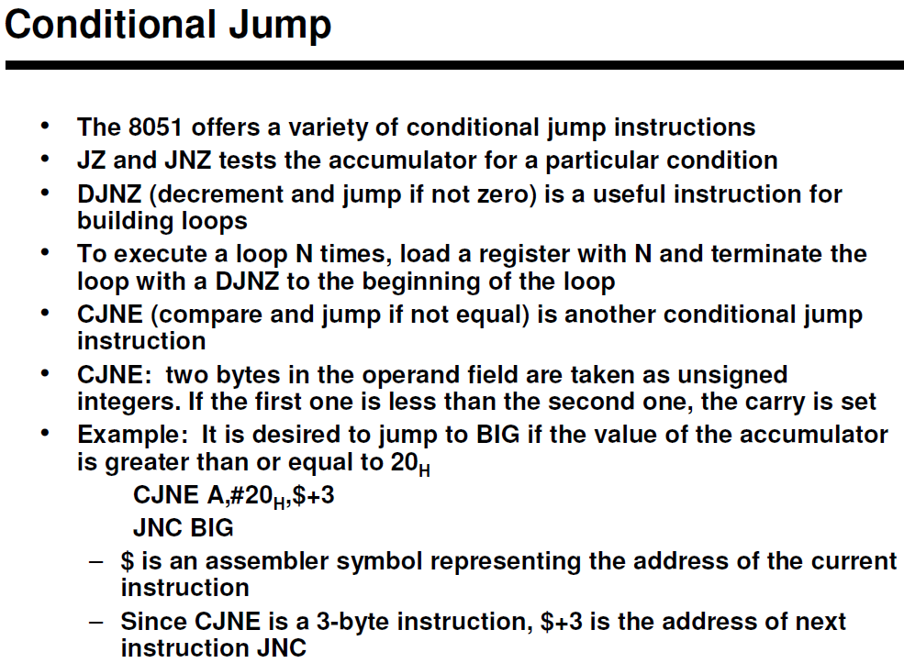

Slide 55
Conditional Jump Example
Write a program to determine if R5 contains the value 0. If so, out 55H in it.
Solution??

Slide 56
Conditional Jump Example
Write a program to determine if R5 contains the value 0. If so, out 55H in it.
Solution
MOV A, R5 ; Copy r5 to a
JNZ NEXT ; Jump If A Is Not Zero
NEXT: …

Slide 57
Conditional Jump Example
Find the sum of the values 79H, F5H, and E2H. Put the sum in registers R0 (low byte) and R5 (high byte)
Solution???

Slide 58
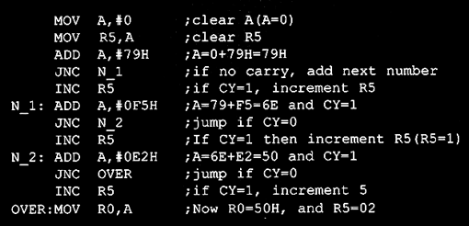
Conditional Jump Example
Find the sum of the values 79H, F5H, and E2H. Put the sum in registers R0 (low byte) and R5 (high byte)
Solution:

Slide 59
Unconditional Jump Instructions
All conditional jumps are short jumps
Target address within -128 to +127 of PC
LJMP (long jump): 3-byte instruction
2-byte target address: 0000 to FFFFH
Original 8051 has only 4KB on-chip ROM
SJMP (short jump): 2-byte instruction
1-byte relative address: -128 to +127

Slide 60
Call Instructions
LCALL (long call): 3-byte instruction
2-byte address
Target address within 64K-byte range
ACALL (absolute call): 2-byte instruction
11-bit address
Target address within 2K-byte range

